Slide 1

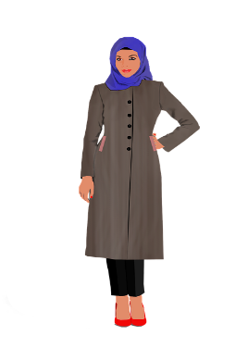

Walk in her shoes
A refugee’s journey from Syria to liverpool – 5,668,200 steps
Average woman in the uk – 16,000 steps
WHISC is a charity dedicated to improving the health and wellbeing of women and their families throughout Liverpool and the surrounding areas
45% of our service users are Black, Asian, Minority Ethnic and Refugee
Stay at home parent – 13,813 steps
47% of our service users have at least one dependent child in their household
Nurse – 16,390 steps
89.3% of nurses in the UK are female
Refugee
Welcome
Over 55’S – 7000 STEPS
Hospitality Worker
Welcome
28% of our service users are 40-60 and 9% are aged 60+
Welcome
Nurse
Welcome
Welcome
Welcome
Welcome
Woman with disability -3185 steps
Average Woman
Welcome
Welcome
Welcome
Welcome
Welcome
56% of all service users declared themselves to have either a physical or mental disability (or both)
Stay at home parent
Welcome
Welcome
Welcome
Over 55’s
Woman with disability
Hospitality worker – 22,778 steps
Just over half of all (56%) people working in hospitality in the UK are women (The Change Group 2018)
Notes:
https://www.workingmums.co.uk/being-a-woman-in-the-hospitality-industry/

